Slide 1


Slide 2

BREAST CANCER DIAGNOSIS
Aim – To predict whether the tumor is benign or malignant.
TANISHA KALIRAMAN

Slide 3
Breast Cancer
Breast cancer is a type of cancer that forms in the cells of the breasts. It can occur in both men and women, but it is far more common in women. Breast cancer is the second most common cancer in women worldwide.
Benign vs. Malignant:
Benign Breast Tumors: These are non-cancerous growths in the breast. They are not life-threatening and do not spread to other parts of the body. Common examples include fibroadenomas and cysts.
Malignant Breast Tumors (Breast Cancer): These are cancerous tumors that can invade nearby tissues and spread to other parts of the body.

Slide 4
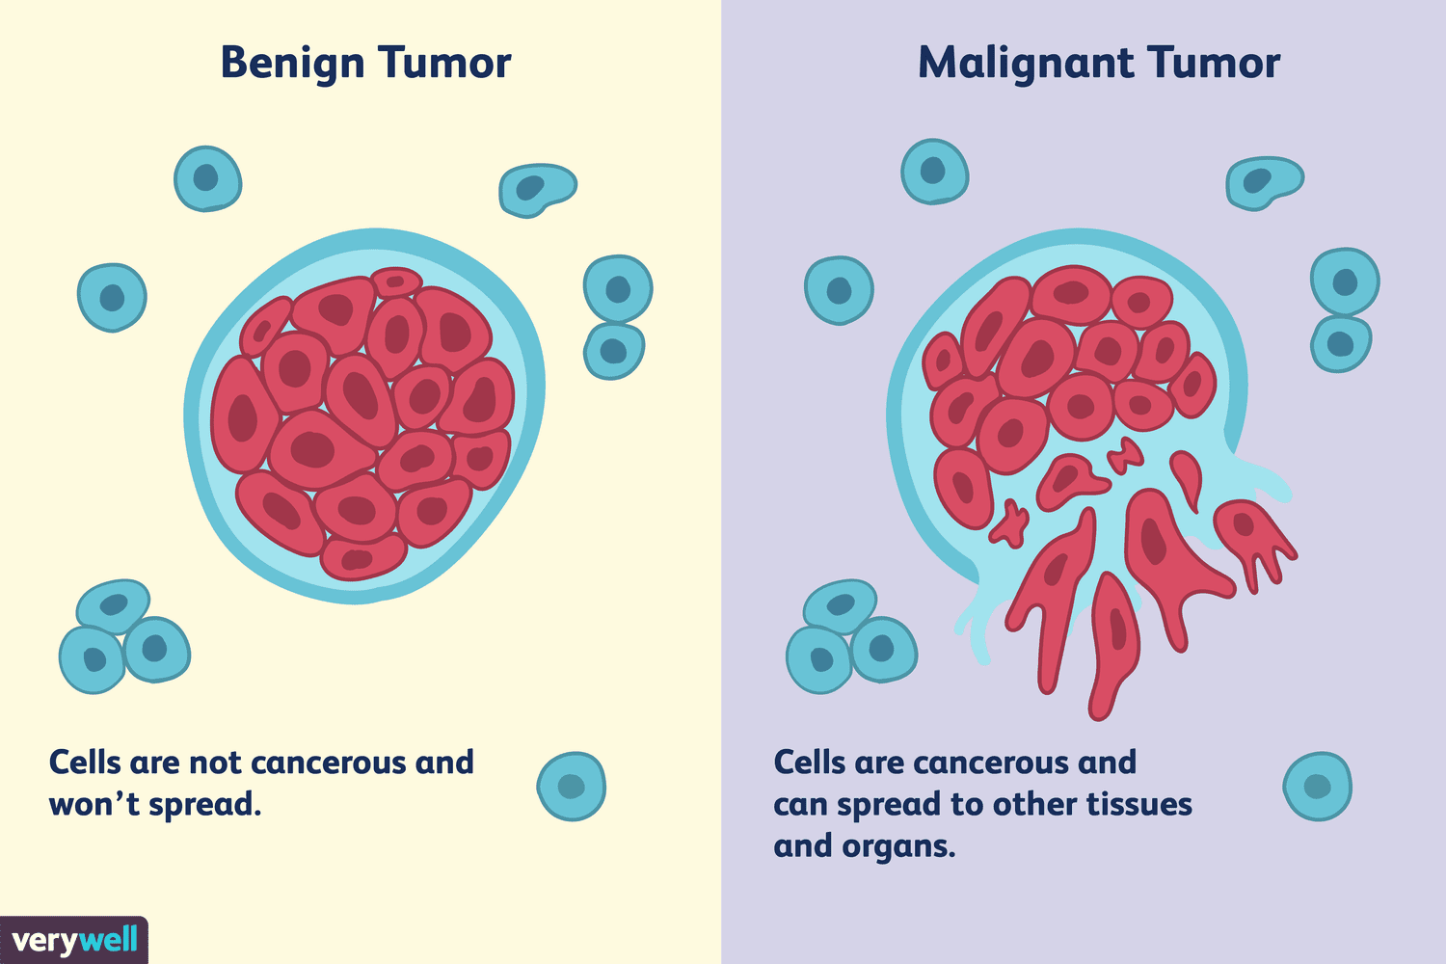

Slide 5
What is the dataset about?
Features are computed from a digitized image of a fine needle aspirate (FNA) of a breast mass. They describe characteristics of the cell nuclei present in the image.
The specific features related to cell nuclei are denoted with "_mean," "_se," and "_worst" in their names.

Slide 6
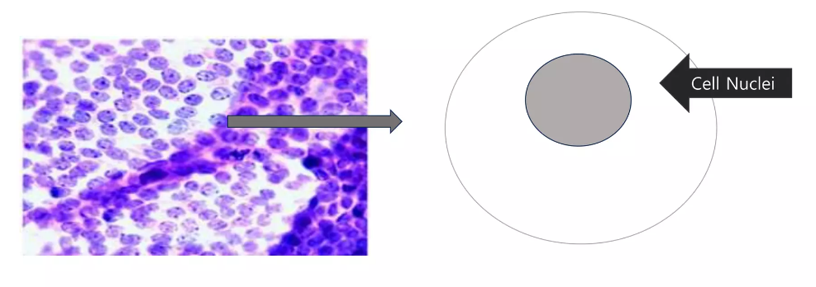
Parameters are measured from a fine needle aspirate of a breast mass.
Parameters are about the cell nucleus (569 cells).

Slide 7
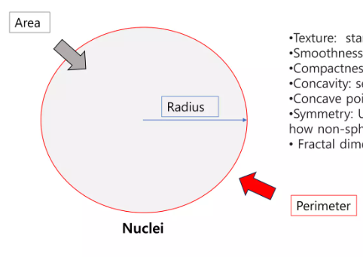
Parameters/Features include:
Radius
Texture
Perimeter
Area
Smoothness
Compactness (Perimeter^2 / area – 1)
Concavity (severity of concave portions of the contour)
Concave points (number of concave portions of the contour)
Symmetry
Fractal dimension

Slide 8
Structure of the dataset
MEAN
10
FEATURES
STANDARD ERROR (SE)
WORST
+ UNNAMED + ID + DIAGNOSIS }
30 FEATURES = 33 COLUMNS

Slide 9
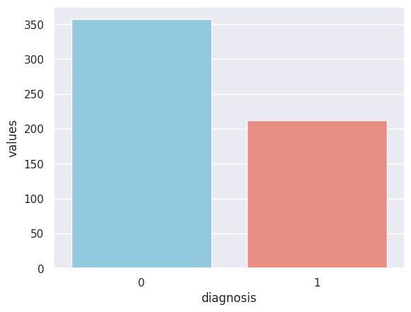
EXPLORATORY DATA ANALYSIS
This graph shows the spread of instances like the number of Benign and Malignant cases present in the data.
0 – Benign Tumor
1 – Malignant Tumor

Slide 10
CORRELATIONS

Slide 15
Thank You!!

